Slide 1
Lens and Perspective

Slide 2
Lens
The framework through which you are looking at an issue/topic/framework
There are eight lenses identified in our course description:
  Environmental
  Scientific
  Economic
  Political/historical
  Artistic/philosophical
  Cultural/social
  Futuristic
  Ethical/moral
  (some of these may overlap, that is completely ok!)

Slide 3
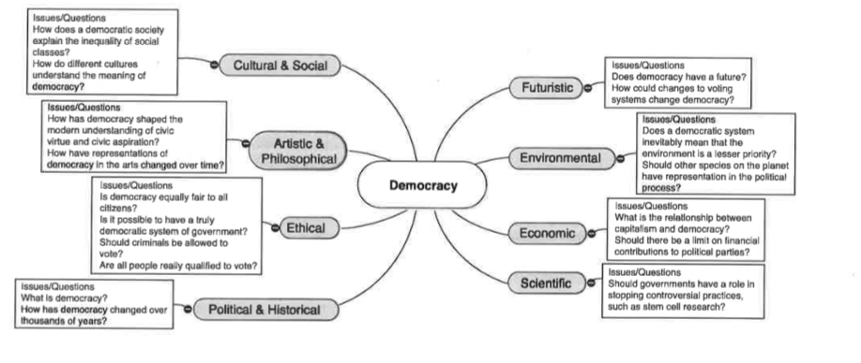
Lens example

Slide 4
Perspective
A point of view that is conveyed through an argument
Full arguments often draw on multiple perspectives
Perspective is also the stake holder or people/persons involved in the issue

Slide 5
Perspective example
Lens from before: Democracy and Futuristic
  How could changes to voting systems change democracy?
    Perspectives:
      Voters; citizens
      Parties that try to get candidates elected
      Communities that host voting
      Candidates

Slide 7
Confused? That is ok!
Don’t stress. It’s almost a rite of passage NOT to know what the difference between ‘lens’ and ‘perspective’ is during Year One.
A lens is used to narrow the scope of a student’s research efforts; he/she is then responsible for unearthing multiple perspectives WITHIN that lens. After identifying these varying viewpoints, students must then analyze them before arriving at a judgment about the issue as a whole.

Slide 8
Practice
Small group and the lens/perspective worksheet
  Identify one current event
  Put the issue in the center
  Work with your group to identify questions and/or perspectives within each of our 8 lenses.
Individually: Worksheet on schoology

