Slide 1
What is an argument?
(hint: not just a fight!)

Slide 2
Basic
People express their ideas, points of view, perspectives and conclusions through arguments.
The main idea of an argument is the main point the author is trying to make
Crafting an argument requires
a clear line of reasoning
Considering audience
Purpose
context

Slide 3
Reason and Evidence
Arguments use reason and evidence to convey a perspective, point of view, or some version of the truth that is either directly stated or implied
Arguments are supported and unified by carefully selected and connected claims, reasons and evidence
An argument may also acknowledge other arguments and/or response to them with counterarguments

Slide 4
Line of reasoning
The line of reasoning is a clear, logical and sequential path leading the audience through the reasons toward the conclusion
The LOR is organized based on the argument and the purpose
In a nutshell: reasons or claims the author uses to support his or her main idea

Slide 5
Evidence
Compelling evidence is used to suppoer the claims and reasoning of the argument
Evidence must be
Sufficient
Typical
Relevant
Current
Credible

Slide 6
Questions to ask when reading for argument
Does tha author have an argument? If yes, what is the main idea?
What reasons does the author give to support his or her main idea?
What evidence does tha author use to support these reasons? Is it credible? Is it biased?
Are these reasons and evidence convincing? Why or why not? Are there implicit assumptions?
What do you think was the author’s purpose in writing/creating this piece?

Slide 7
Questions continued
Are the reasons presented in a logical order, as a line of reasoning? Do the reasons clearly link to one another and to the conclusion/thesis?
Does the author make a reasoned evaluation of other people’s views that contradict their own (ie does the auther address counter-arguments?
What are the implications if the reader accepts the argument?

Slide 8
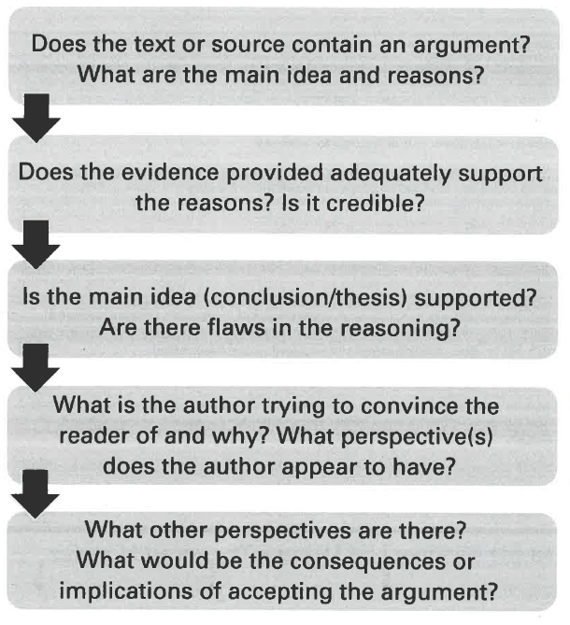
Putting an argument in context

